Slide 1
GrapeShoot Marketing Review

Slide 2
Overview of Total Metrics
Campaign Platform Analysis
Campaign-Type Analysis
Creative Performance
Regional Impact

Slide 3
Overview of Our Total Metrics for the Year
SUM of Cost | SUM of Impressions | SUM of Clicks | SUM of Conversions | SUM of Revenue | AVERAGE of CTR (Click-Through-R | AVERAGE of CPA (Cost Per Aquisition) | AVERAGE of CPC (Cost Per Click) | AVERAGE of ROAS (Return on Ad Spend)
$63,728,754.42 | 1007626131 | 25986869 | 1970051 | $148,085,181.44 | 6.205225903 | 78.02495469 | 10.90008923 | 5.187129578

Slide 4
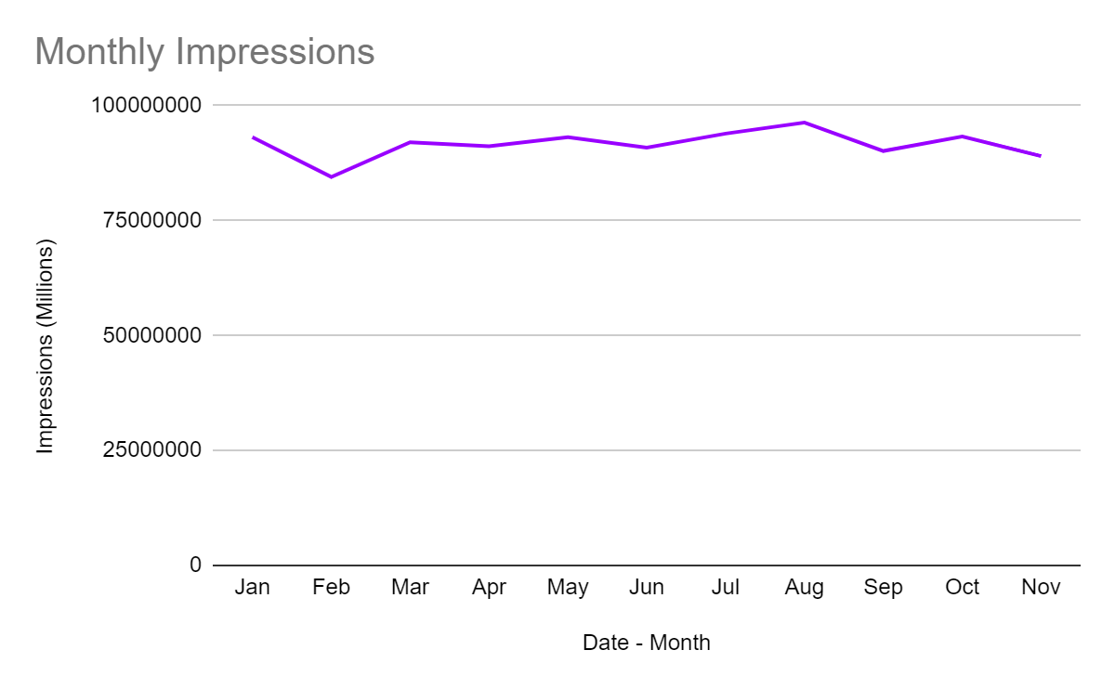
Monthly Impressions throughout the year constant

Slide 5
Campaign-Wise Analysis

Slide 6
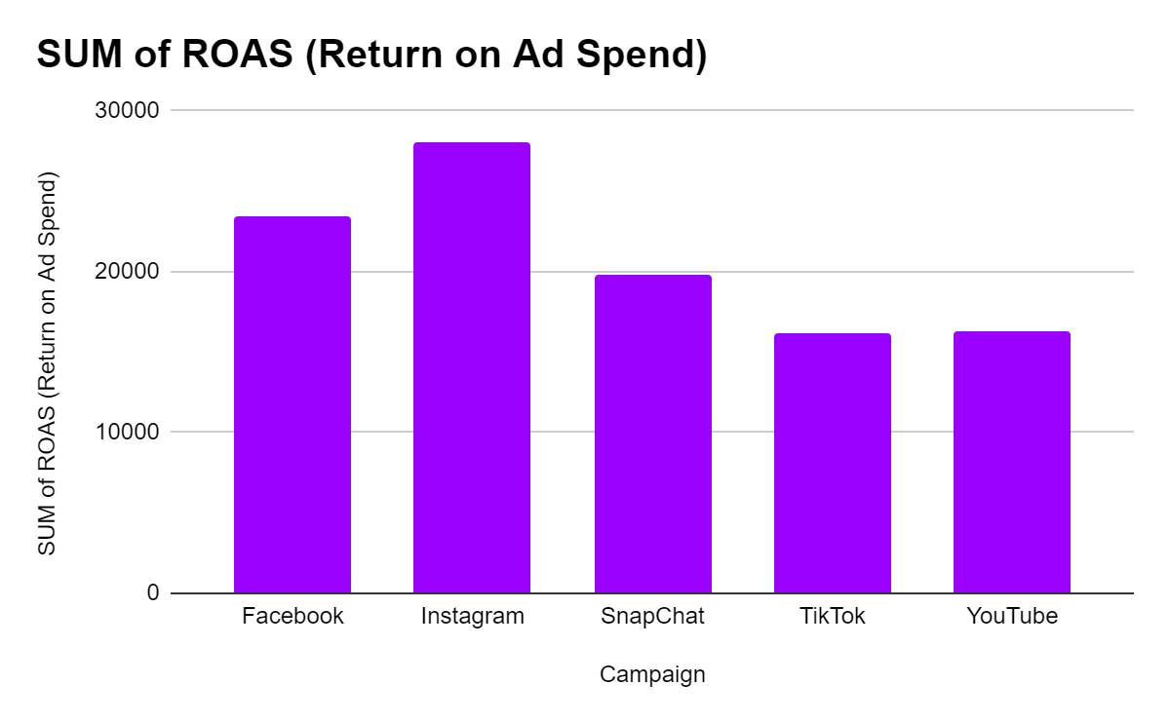
Instagram leads in the highest ROAS (Return On Ad Spend)
Instagram leads in the highest ROAS meaning that Instagram accumulated the most revenue for every dollar spent on advertisement.

Slide 7
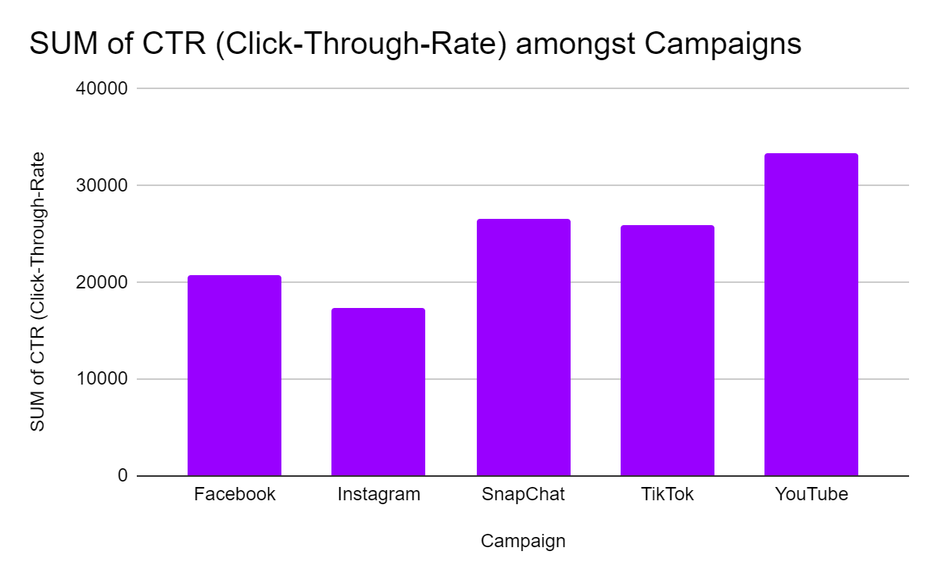
Youtube leads the way in Engagement
Youtube dominated the other social media platforms when it came to engagement.

Slide 8
Campaign-type Analysis

Slide 9
Campaign Type Analysis
Campaign Type | Total Spend | Spend of CTR | Spend of CPA | Spend of CPC
Prospecting | $32,124,169.14 | 62041.57926 | 777991.174 | 111020.17
Retargeting | $31,604,585.28 | 62062.9388 | 782507.9199 | 106981.6146
Grand Total | $63,728,754.42 | 124104.5181 | 1560499.094 | 218001.7846
● Prospecting campaigns are cost-effective with a competitive CPC and moderate CPA, making them efficient for acquiring new customers.
● Retargeting campaigns exhibit a higher CTR but come with a higher CPA, suggesting a focused strategy on re-engaging previous visitors with potentially higher acquisition costs.

Slide 10
Regional Analysis

Slide 11
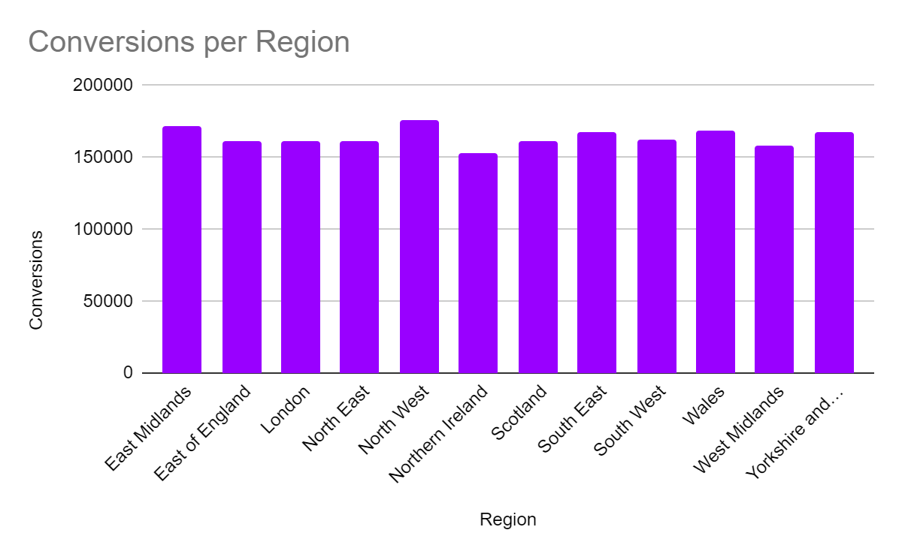
Number of Conversions from around the country
The number of conversions around the country are relatively similar. The North West and region of East Midlands lead with the highest number of conversions at 175,403 and 172,029 respectively, indicating strong performance in driving desired actions.

